Slide 1



















Tahaluf Copyright 2022- All Right Reserved
Harmony IT Solution
learning Hub
Angular
Tahaluf Training Center 2022

Slide 2









Tahaluf Copyright 2022- All Right Reserved
Harmony IT Solution
1
Reusable component.
2
Input Decorator.
3
Output Decorator.
4
5
6
7
8
8
9

Slide 3










Tahaluf Copyright 2022- All Right Reserved
Harmony IT Solution
Objective

Slide 4
Tahaluf Copyright 2022- All Right Reserved
Harmony IT Solution
The Objective of this lecture
Get to know about the reusable component concept and its purpose for it.
The Input and output decorator and what the purpose for using these decorators.

Slide 5
Tahaluf Copyright 2022- All Right Reserved
Harmony IT Solution
Reusable Component

Slide 6
Tahaluf Copyright 2022- All Right Reserved
Harmony IT Solution
Overview of Reusable Component
It defines a base structure and behavior that can be used in different contexts/dynamic content.
With every reusable component, we have a parent component.
In the reusable component, this flexible content comes from parent content and ends up in a dedicated slot.
In other words, it is projected down to the parent component.

Slide 7
Tahaluf Copyright 2022- All Right Reserved
Harmony IT Solution
The Purpose of Reusable Component
Efficiency: Using the same markup across components, making future changes easy.
Consistency: Whenever reusable components are updated, they get affected across all of their uses.
Easy to Test: Testing becomes easier when SRPs are followed.

Slide 8
Tahaluf Copyright 2022- All Right Reserved
Harmony IT Solution
Demo of Reusable Component

Slide 9
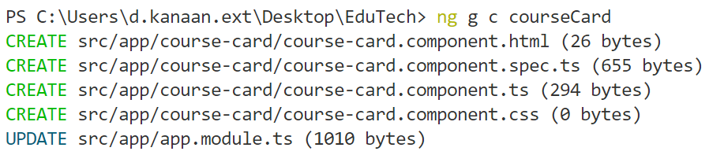

Tahaluf Copyright 2022- All Right Reserved
Harmony IT Solution
Reusable Component Example
Create a new component called CourseCard.
Note: This component will contain the reusable code.

Slide 10
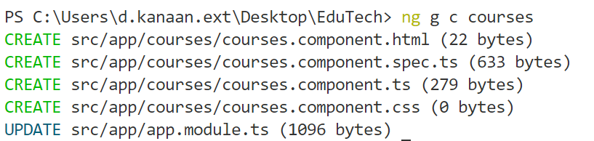
Tahaluf Copyright 2022- All Right Reserved
Harmony IT Solution
Reusable Component Example
Create another component called courses.

Slide 11
Tahaluf Copyright 2022- All Right Reserved
Harmony IT Solution
Reusable Component Example
Add the routing for the course component.
In-app-routing.module.ts
{
path:'course',
component:CoursesComponent
}

Slide 12
Tahaluf Copyright 2022- All Right Reserved
Harmony IT Solution
Reusable Component Example
The course card component template will be the cards for each course in the system.
So instead of repeating the card more than once according to the number of courses in the system, we resort to using the principle of reusable components.

Slide 13
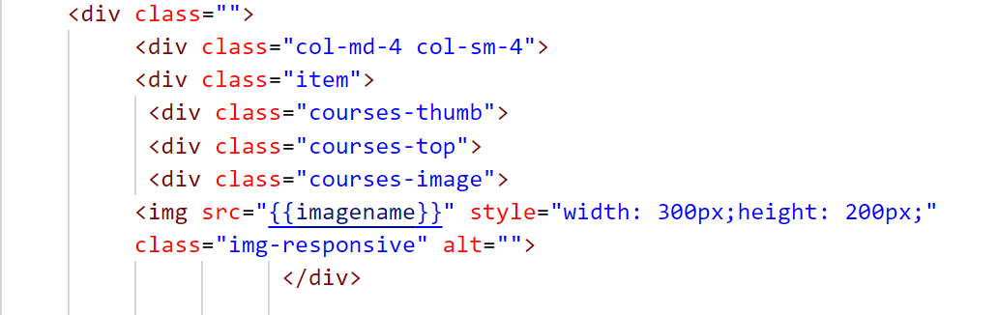
Tahaluf Copyright 2022- All Right Reserved
Harmony IT Solution
Reusable Component Example
In the courseCard.compoment.html :
Notes:
<div class="">
<div class="col-md-4 col-sm-4">
<div class="item">
<div class="courses-thumb">
<div class="courses-top">
<div class="courses-image">
<img src=“{{imagename}}" style="width: 100px;
height: 100px;"class="img-responsive" alt=""></div>

Slide 14
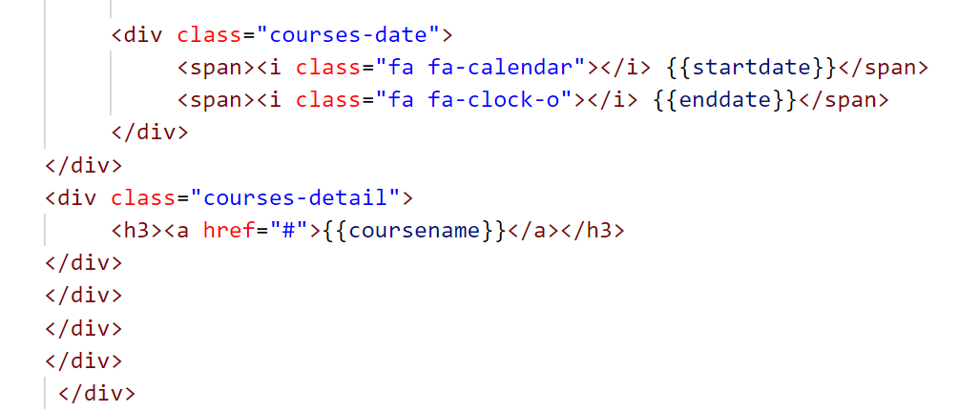
Tahaluf Copyright 2022- All Right Reserved
Harmony IT Solution
Reusable Component Example
In the courseCard.compoment.html :
Notes:
<div class="courses-date">
<span><i class="fa fa-calendar"></i> {{startdate}}</span>
<span><i class="fa fa-clock-o"></i> {{enddate}}</span>
</div>
</div><div class="courses-detail">
<h3><a href="#">{{coursename}}</a></h3>
</div></div>
</div>
</div>
</div>

Slide 15
Tahaluf Copyright 2022- All Right Reserved
Harmony IT Solution
Reusable Component
There is more than one way to send data from parent to child component.
Using the Input and Output decorator.

Slide 16
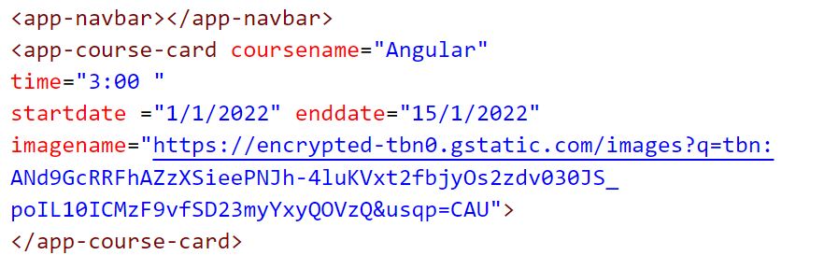
Tahaluf Copyright 2022- All Right Reserved
Harmony IT Solution
Sending the data as properties in the parent-child component Example :
In course.component.html :
Notes:
<app-navbar></app-navbar>
<app-course-card coursename="Angular" time="3:00 "startdate ="1/1/2022" enddate="15/1/2022" imagename="https://encrypted-tbn0.gstatic.com/images?q=tbn:
ANd9GcRRFhAZzXSieePNJh-4luKVxt2fbjyOs2zdv030JS_
poIL10ICMzF9vfSD23myYxyQOVzQ&usqp=CAU">
</app-course-card>

Slide 17
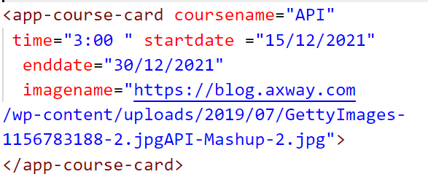
Tahaluf Copyright 2022- All Right Reserved
Harmony IT Solution
Sending the data as properties in the parent-child component Example :
In course.component.html:
Notes:
<app-course-card coursename="API" time="3:00 " startdate ="15/12/2021" enddate="30/12/2021" imagename="https://blog.axway.com
/wp-content/uploads/2019/07/GettyImages-
1156783188-2.jpgAPI-Mashup-2.jpg">
</app-course-card>

Slide 18
Tahaluf Copyright 2022- All Right Reserved
Harmony IT Solution
Input Decorator

Slide 19
Tahaluf Copyright 2022- All Right Reserved
Harmony IT Solution
Overview of Input Decorator
@Input is a decorator for marking a property as an input.
It can be used to specify a component property.
Allows data to be passed between parent and child components (property binding).
Component properties should be annotated with the @Input decorator to act as input properties.

Slide 20
Tahaluf Copyright 2022- All Right Reserved
Harmony IT Solution
Input Decorator Example
Step One :
Start with creating an array to store the properties for each selector.
(Each selector represents an object within this array)

Slide 21
Tahaluf Copyright 2022- All Right Reserved
Harmony IT Solution
Input Decorator Example
So in courses.component.ts :
courses:any=[{
coursename:'API’,
startdate:'15/12/2021',
enddate:'30/12/2021',
imagename:"https://blog.axway.com/wp-content/uploads/
2019/07/GettyImages-1156783188-2.jpgAPI-Mashup-2.jpg"
},

Slide 22
Tahaluf Copyright 2022- All Right Reserved
Harmony IT Solution
Input Decorator Example
,{
coursename:"Angular",
startdate:"1/1/2022",
enddate:"15/1/2022",
imagename:"https://encrypted- tbn0.gstatic.com/images?q=tbn:ANd9GcRRFhAZzXSieePNJh-4luKVxt2fbjyOs2zdv030JS_poIL10ICMzF9vfSD23myYxyQOVzQ&usqp
=CAU"},
{coursename:"Scrum",
startdate:"18/1/2022",
enddate:"21/1/2022",
imagename:"https://i2.wp.com/iraqtech.io/wp-content/
uploads/Agile-framwork.jpg"}]

Slide 23
Tahaluf Copyright 2022- All Right Reserved
Harmony IT Solution
Input Decorator Example
Step Two :
Open parent component views (courses.component.html) then pass this variable to the child component instance, which is passed to the parent component.
<app-course-card *ngFor="let obj of courses"
[coursename]="obj.coursename“
[startdate] ="obj.startdate"
[enddate]="obj.enddate" [imagename]="obj.imagename">
</app-course-card>

Slide 24
Tahaluf Copyright 2022- All Right Reserved
Harmony IT Solution
Input Decorator Example
Step Three :
Import the input on the child component (course card component).
So, in the courseCard.component.ts

Slide 25
Tahaluf Copyright 2022- All Right Reserved
Harmony IT Solution
Input Decorator Example
Step Four :
Create variables that are passed from the parent component to the child component.
In the coursCard.component.ts
@Input() coursename :string|undefined
@Input() startdate :string|undefined
@Input() enddate :string|undefined
@Input() teachercourse :string|undefined
@Input() imagename :string|undefined

Slide 26
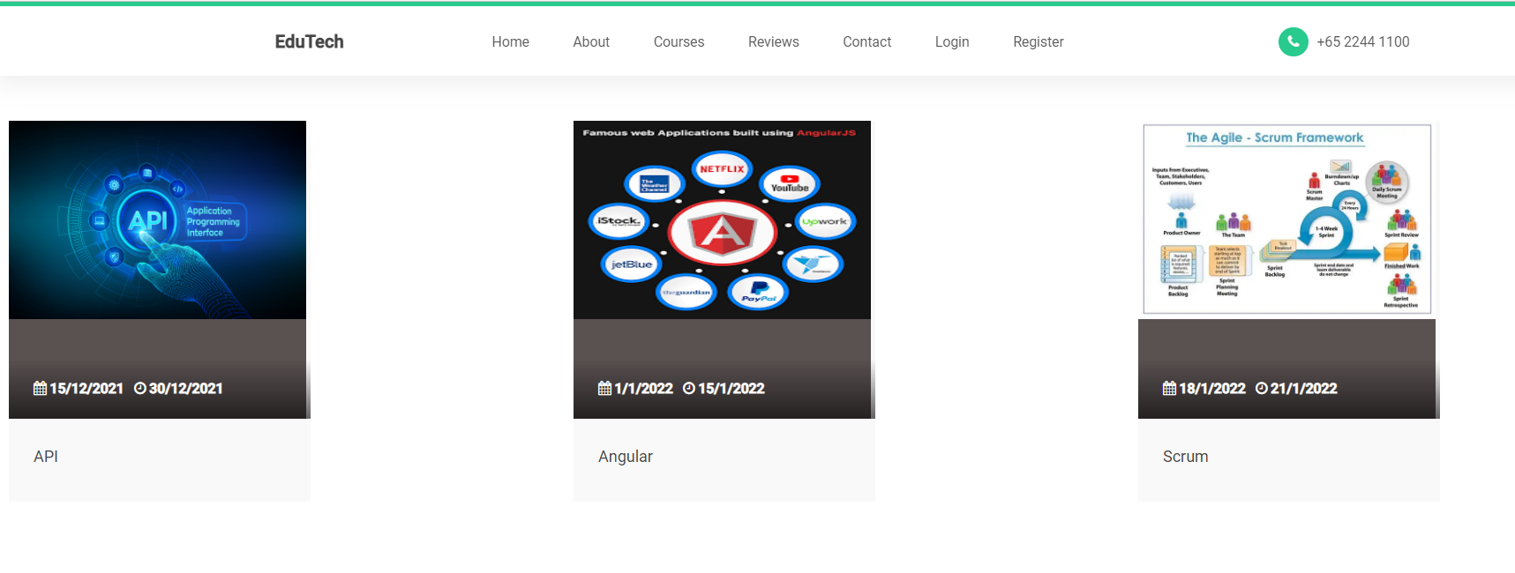
Tahaluf Copyright 2022- All Right Reserved
Harmony IT Solution
The Example Result

Slide 27
Tahaluf Copyright 2022- All Right Reserved
Harmony IT Solution
Output Decorator

Slide 28
Tahaluf Copyright 2022- All Right Reserved
Harmony IT Solution
Overview of Output Decorator
In the @Output decorator, data is passed from the child to the parent component.
This annotation binds a property of type Angular EventEmitter.
Use it in components with the @Output directive to emit custom events synchronously or asynchronously.

Slide 29
Tahaluf Copyright 2022- All Right Reserved
Harmony IT Solution
Output Decorator Example
Create an instance of the eventEmmiter class In the child component to emit the output event in the parent component.
@Output() opneProfile=new EventEmitter();

Slide 30

Tahaluf Copyright 2022- All Right Reserved
Harmony IT Solution
Exercises
Generate a new component called profile and give it a routing.
Notes:
In the terminal :
ng g c profile
In the app-routing.module.ts
,{
path:'profile',
component:ProfileComponent
}

Slide 31
Tahaluf Copyright 2022- All Right Reserved
Harmony IT Solution
Exercises
Create an output event that redirects to the profile component when the user clicks on the course image.
Notes:
In the terminal :
ng g c profile
In the app-routing.module.ts
,{
path:'profile',
component:ProfileComponent
}

Slide 32
Tahaluf Copyright 2022- All Right Reserved
Harmony IT Solution
Exercises _ Solution
In the child views (courseCard.component.html)
Add the click event in the image tag
<img (click)="showPorfile()" src="{{imagename}}" style="width: 300px;height: 200px;"
class="img-responsive" alt="">
Notes:
In the terminal :
ng g c profile
In the app-routing.module.ts
,{
path:'profile',
component:ProfileComponent
}

Slide 33
Tahaluf Copyright 2022- All Right Reserved
Harmony IT Solution
Exercises _ Solution
Then implement the show profile function in the courseCard.component.ts
showPorfile(){
this.router.navigate(['profile']); }
Note: Don’t forget to define an instance of the router class in the constructor.
Notes:
In the terminal :
ng g c profile
In the app-routing.module.ts
,{
path:'profile',
component:ProfileComponent
}

Slide 34
Tahaluf Copyright 2022- All Right Reserved
Harmony IT Solution
Exercises _ Solution _ 2
Using the output decorator to pass the data from the child to the parent component.
The show profile function will emit the open profile that is passed to the parent component (course component).
Notes:
In the terminal :
ng g c profile
In the app-routing.module.ts
,{
path:'profile',
component:ProfileComponent
}

Slide 35
Tahaluf Copyright 2022- All Right Reserved
Harmony IT Solution
Exercises _ Solution _ 2
Step One
Import the output decorator and the Event Emitter in the child component (course card component).
In courseCard.component.ts
import { Component, EventEmitter, Input, OnInit, Output }
from '@angular/core';
Notes:
In the terminal :
ng g c profile
In the app-routing.module.ts
,{
path:'profile',
component:ProfileComponent
}

Slide 36
Tahaluf Copyright 2022- All Right Reserved
Harmony IT Solution
Exercises _ Solution _ 2
Step Two
Create an instance of Event Emitter in the child component.
@Output() opneProfile=new EventEmitter();
Notes:
In the terminal :
ng g c profile
In the app-routing.module.ts
,{
path:'profile',
component:ProfileComponent
}

Slide 37
Tahaluf Copyright 2022- All Right Reserved
Harmony IT Solution
Exercises _ Solution _ 2
Step Three
In the child component views (courseCard.component.html)
<img (click)=goToProfile()" src="{{imagename}}" style="width: 300px;height: 200px;"
class="img-responsive" alt="">
Notes:
In the terminal :
ng g c profile
In the app-routing.module.ts
,{
path:'profile',
component:ProfileComponent
}

Slide 38
Tahaluf Copyright 2022- All Right Reserved
Harmony IT Solution
Exercises _ Solution _ 2
Step Three
In the courseCard.component.ts
goToProfile(){
this.opneProfile.emit();
}
Notes:
In the terminal :
ng g c profile
In the app-routing.module.ts
,{
path:'profile',
component:ProfileComponent
}

Slide 39
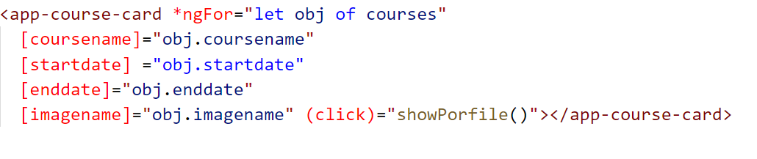
Tahaluf Copyright 2022- All Right Reserved
Harmony IT Solution
Exercises _ Solution _ 2
In the courses.component.html add an output event called show profile.
Notes:
In the terminal :
ng g c profile
In the app-routing.module.ts
,{
path:'profile',
component:ProfileComponent
}

Slide 40
Tahaluf Copyright 2022- All Right Reserved
Harmony IT Solution
References
[1] Angular, “Angular,” Angular.io, 2019. https://angular.io/
[2] “Complete Angular Tutorial For Beginners,” TekTutorialsHub. https://www.tektutorialshub.com/angular-tutorial/
[3]“npm | build amazing things,” Npmjs.com, 2019. https://www.npmjs.com/
[4]“Angular Tutorial for Beginners | Simplilearn,” Simplilearn.com. https://www.simplilearn.com/tutorials/angular-tutorial (accessed Aug. 19, 2022).
Overview of Database

Slide 41
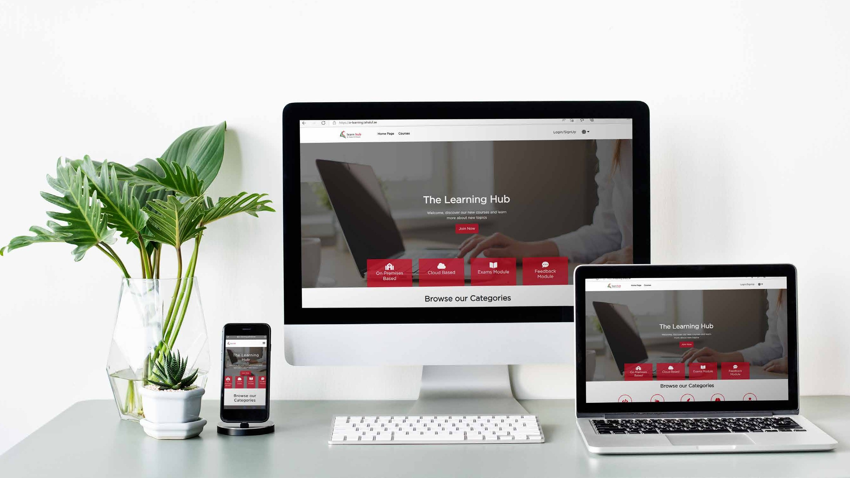







Tahaluf Copyright 2022- All Right Reserved
Harmony IT Solution
Thank youﻂﺤﻧ
Any Question?

